Slide 1
Risk management
How to measure risk’s impact and risk monitoring during course of a project
By Jan-Axel Karlstedt

Slide 2
How to measure risk’s impact
Definition: Risk impact assessment is the process of assessing the probabilities and consequences of risk events if they are realized
First, risks are identified and assessed
The results of this assessment are then used to prioritize risks to establish a most-to-least-critical importance ranking.
Risk are then monitored
Risks are then mitigated depending on severity

Slide 3
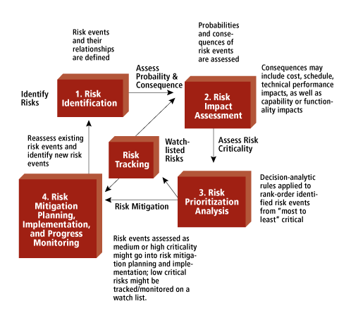
How to measure risk’s impact
Figure 1. Risk Management: Fundamental Steps (Mitre.org, 2019)

Slide 4
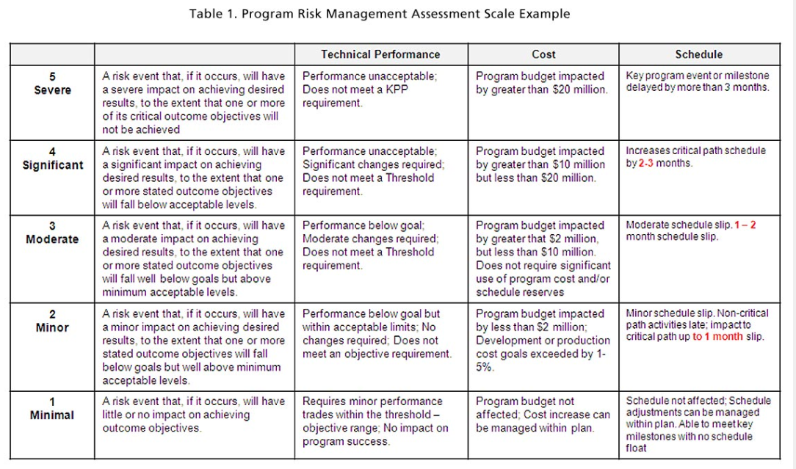
Source: www.mitre.org

Slide 5
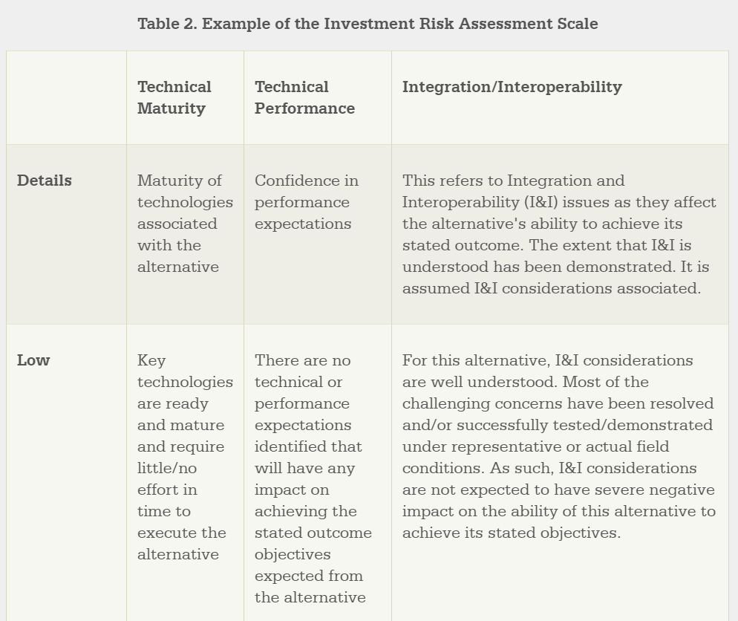
Source: www.mitre.org

Slide 6
Risk monitoring during course of a project
A major purpose of prioritizing risks is to form a basis for allocating resources
Risk management includes the following tasks:
Identify risks and their triggers
Classify and prioritize all risks
Craft a plan that links each risk to a mitigation
Monitor for risk triggers during the project
Implement the mitigating action if any risk materializes
Communicate risk status throughout project

Slide 7
Risk monitoring during course of a project
For most software development projects, there are five main risk impact areas:
New, unproven technologies
Changing tools, techniques, protocols, standards, and development systems bring risk
User and functional requirements
Requirements can change with discovery, prototyping, and integration activities
Application and system architecture
The wrong direction with a platform, component, or architecture can have disastrous consequences
Performance
Organizational
Find a balance between the needs of the development team and the expectations of the customers

Slide 8
Risk monitoring during course of a project: Monitoring
Monitoring includes:
Publish project status
Revise risk plans according to any major changes in project schedule
Review and reprioritize risks, eliminating those with lowest probability
Brainstorm on potentially new risks after changes to project schedule or scope
When a risk occurs, the corresponding mitigation response should be taken from the risk management plan.

Slide 9
Risk monitoring during course of a project: Mitigation
Mitigating options include:
Accept: Acknowledge that a risk is impacting the project. Make an explicit decision to accept the risk without any changes to the project.
Avoid: Adjust project scope, schedule, or constraints to minimize the effects of the risk.
Control: Take action to minimize the impact or reduce the intensification of the risk.
Transfer: Implement an organizational shift in accountability, responsibility, or authority to other stakeholders that will accept the risk.
Continue Monitoring: Often suitable for low-impact risks, monitor the project environment for potentially increasing impact of the risk.

Slide 10
Case Study 2: International Office Equipment Group Maintenance Accounts
Risks:
New technology
Application and system architecture
Prioritize:
Minimal, Minor, Moderate, Significant, Severe
Plan contingencies:
New technology -> training for managers
Monitor:
Review and reprioritize risks, eliminating those with lowest probability
Mitigation:
Transfer – they were not the original suppliers

Slide 11
References
www.mitra.org - Risk Impact Assessment and Prioritization
www.castsoftware.com - Risk Management in Software Development and Software Engineering Projects

